Slide 1

Linear and Mixed Circuits
Engr. Muhammad Waqas

Slide 2
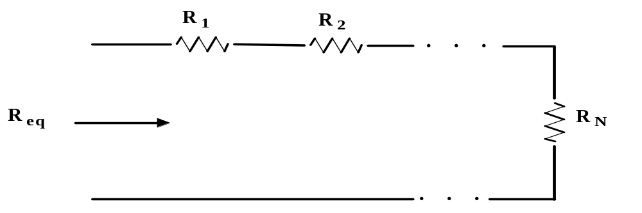
Equivalent Resistance:
We know the following for series resistors:
R_{eq} = R₁ + R₂ + . . . + R_{N}

Slide 3
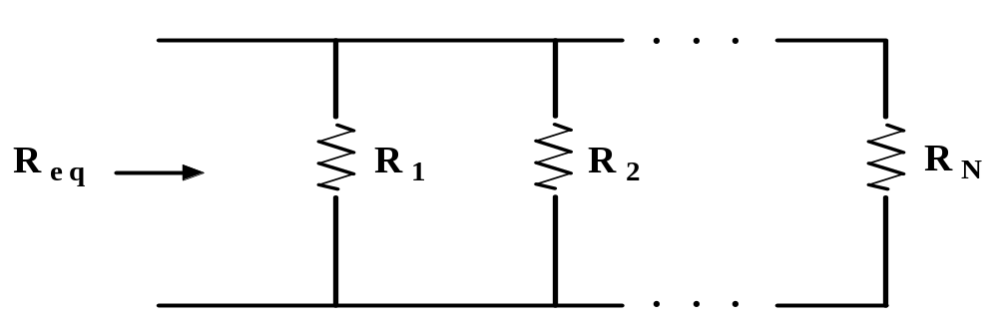
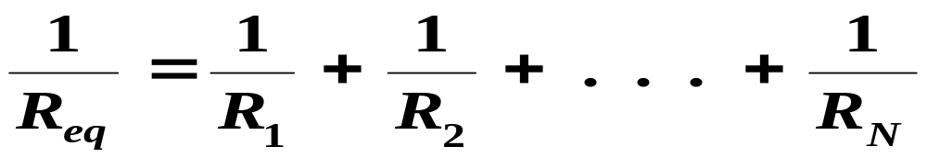
Equivalent Resistance:
We know the following for parallel resistors:

Slide 4
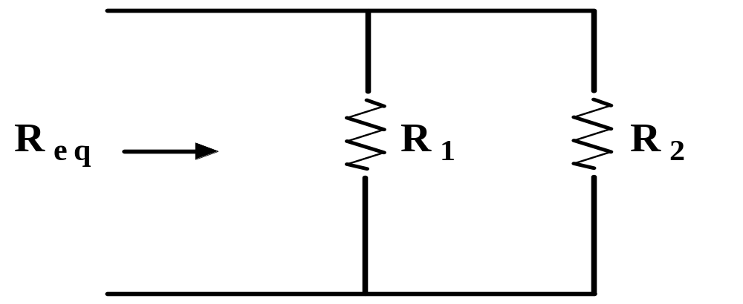
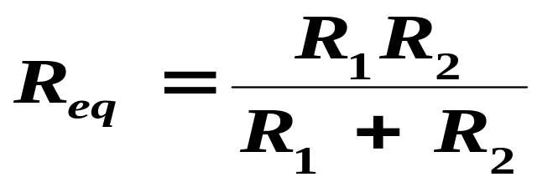
Equivalent Resistance:
For the special case of two resistors in parallel:

Slide 5
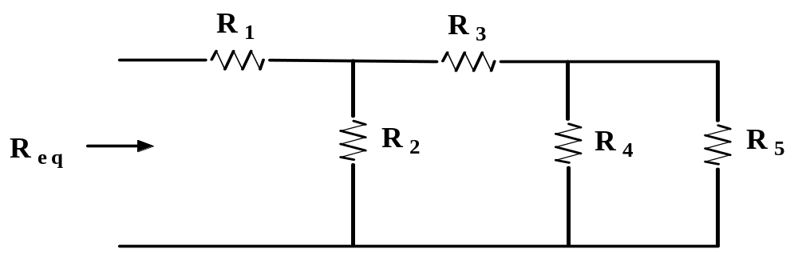
Equivalent Resistance:
Resistors in combination.
By combination we mean we have a mix of series and
Parallel. This is illustrated below.
To find the equivalent resistance we usually start at
the output of the circuit and work back to the input.

Slide 6
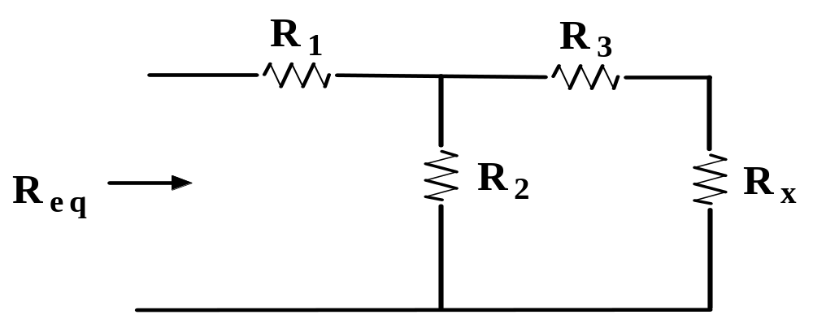
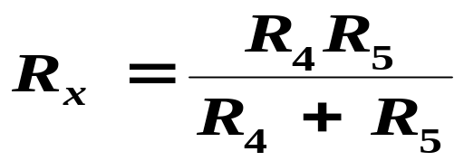
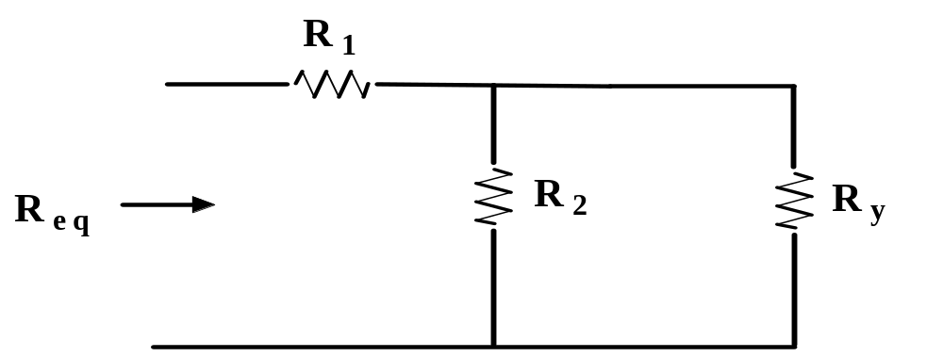
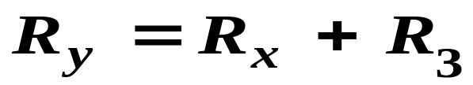
Equivalent Resistance:
Resistors in combination.

Slide 7
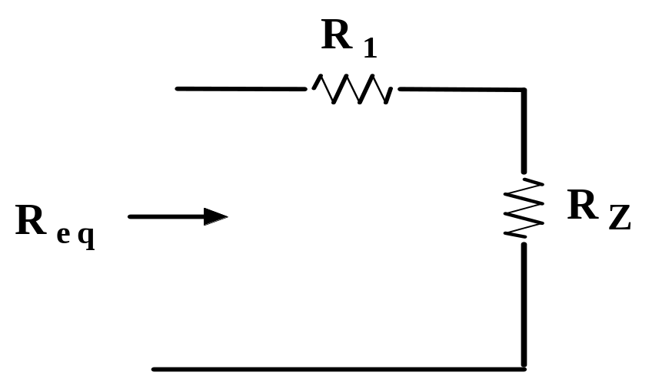

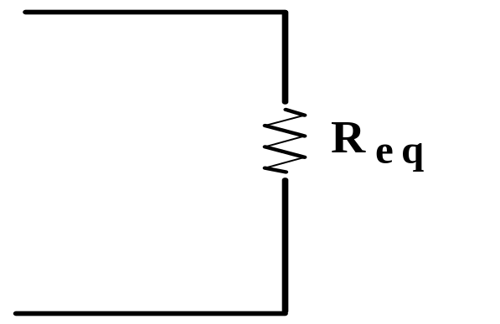

Equivalent Resistance:
Resistors in combination.

Slide 8
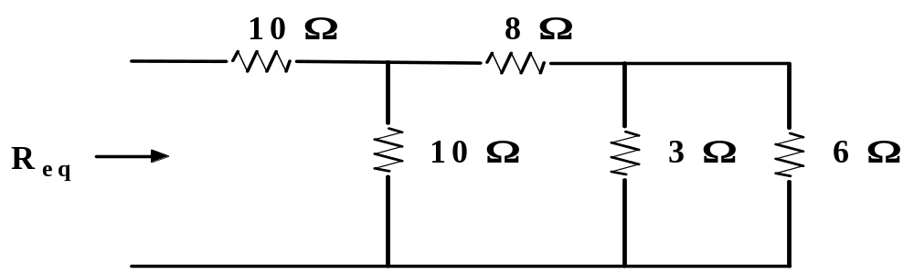
Equivalent Resistance:
Resistors in combination.
It is easier to work the previous problem using numbers than to
work out a general expression. This is illustrated below.
Example 5.1: Given the circuit below. Find R_{eq}.
7

Slide 9
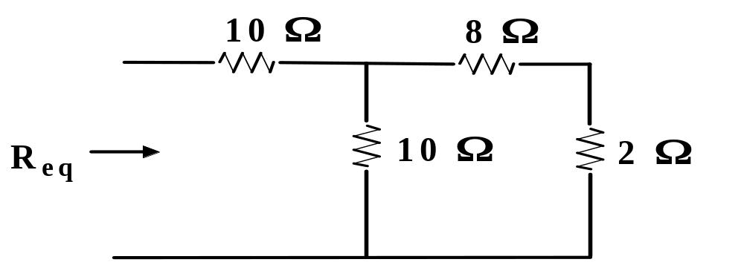
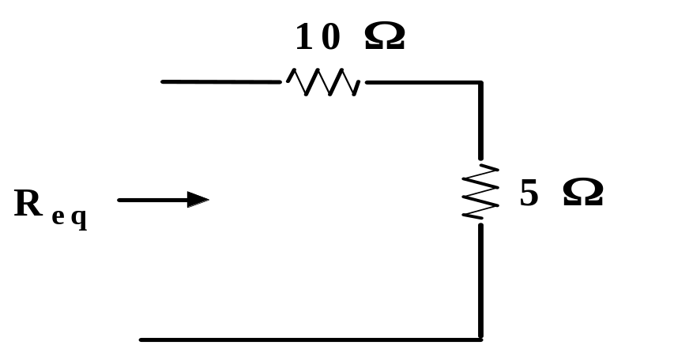

Equivalent Resistance:
Resistors in combination.
.
We start at the right hand side
of the circuit and work to the left.
Ans:

Slide 10
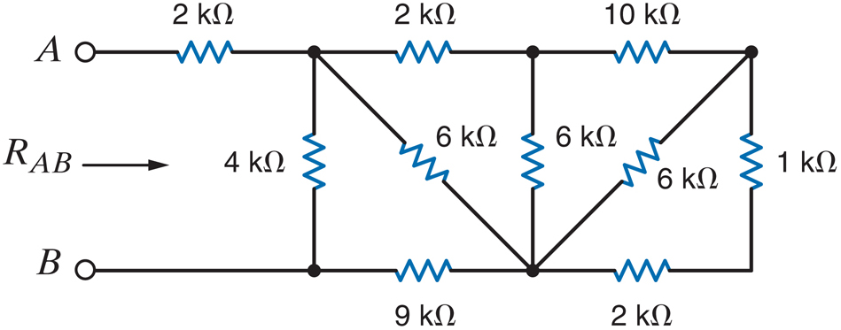
Solve Your Self
ZERO-Grade Quiz

Slide 11
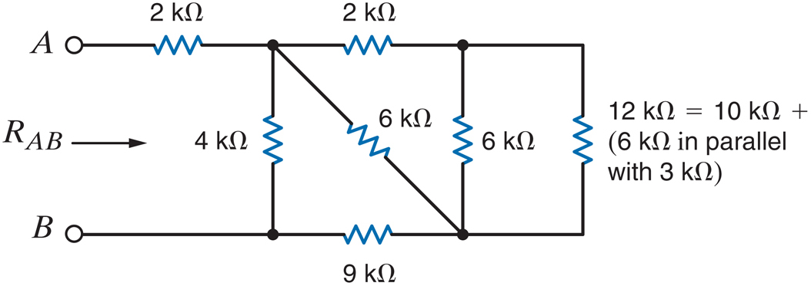
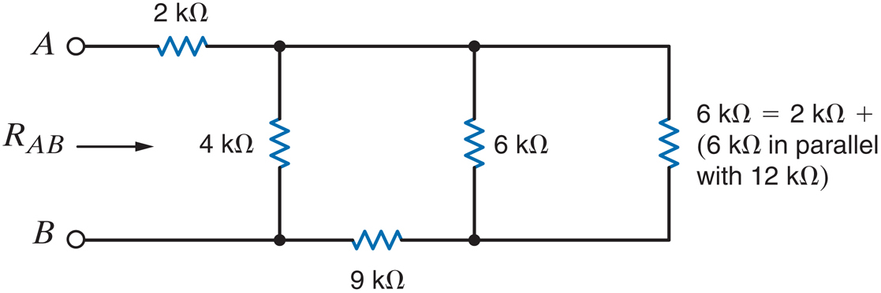

Slide 12
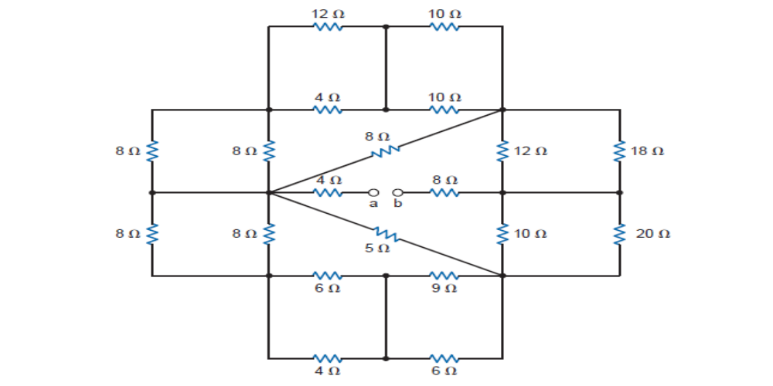

Slide 13
Do some Practice over the Weekend ☺

